Slide 1

PROJECT GUIDE :Smt.Leya G
PRESENTED BY: Vijayasankar V Nair
ROLL NO: 58

Slide 2
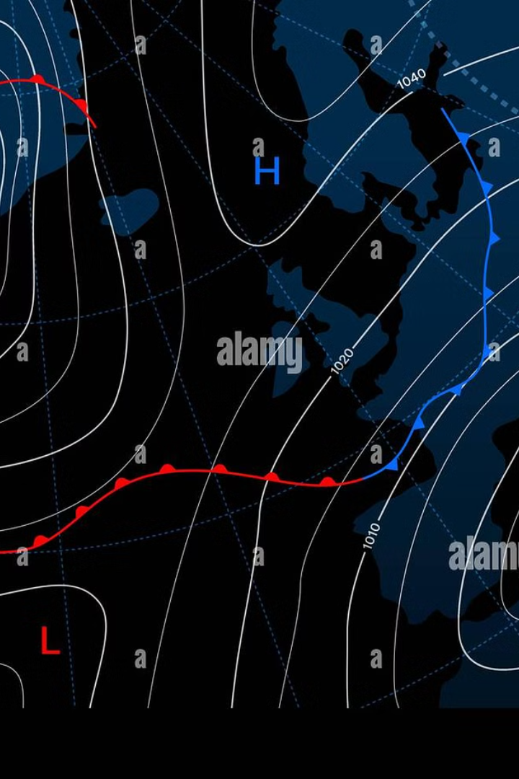
INTRODUCTION
The Flood Prediction Alert System aims to mitigate the effects of flood by providing early warnings based on real-time weather data and historical flood records.
1. The system uses
machine learning models
API (for real time weather data)
2. The system
analyze flood risk
notifies registered users via email alerts

Slide 3

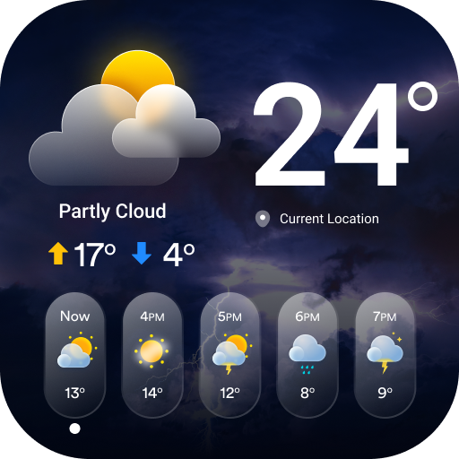
PROBLEM STATEMENT
Floods are a recurring and devastating natural disaster
It pose significant risks to
life
property
infrastructure.
many communities lack effective early warning systems
People are unaware of potential flood threats in there area until its too late.

Slide 4
LITREATURE REVIEW
SI NO | PAPER NAME | AUTHORS | YEAR OF PUBLISHING | ADVANTAGES | DISADVANATAGES
1 | A Real Time Flood Forecasting System Using Machine Learning | John D. Williams, Mark Spencer | 2021 | High Accuracy | High Computational cost,Limited by data quality
2 | Flood Prediction Models Using Neural Networks | Ayesha Kumar,P.Rajeev | 2019 | Prediction Accuracy, Ability to learn from lartge datasets | Requires large training datasets,High sensitivity to parameter tuning
3 | Email based Alert System | Emily Smith,David Brown | 2018 | Effective I n areas with poor connectivity, Ease of use | Delays in email delivery
4 | Machine Learning in Natural Disaster Prediction | Brian Edwards,Sarah Lee | 2017 | Scalability of predictive Models, Continuos model improvement with new data | High initial setup cost, Data collection challenges in remote areas

Slide 5

EXISTING SYSTEM
Current flood prediction and alert systems are functional but have several
limitations that impact their effectiveness.
Reliance on Traditional Hydrological Models
Limited Use of Real-Time Data
Alert Mechanisms
User Engagement

Slide 6
PROPOSED SYSTEM
The Flood Prediction Alert System addresses the limitations of existing systems by
providing a more advanced, location-specific, and timely flood alert solution.
Real-Time Data Integration
Machine Learning for Prediction
User-Friendly Interface
Automated Email Alert System
Scalability and Reliability

Slide 7
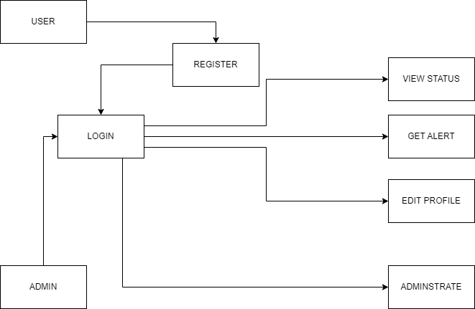
ARCHITECTURE

Slide 8
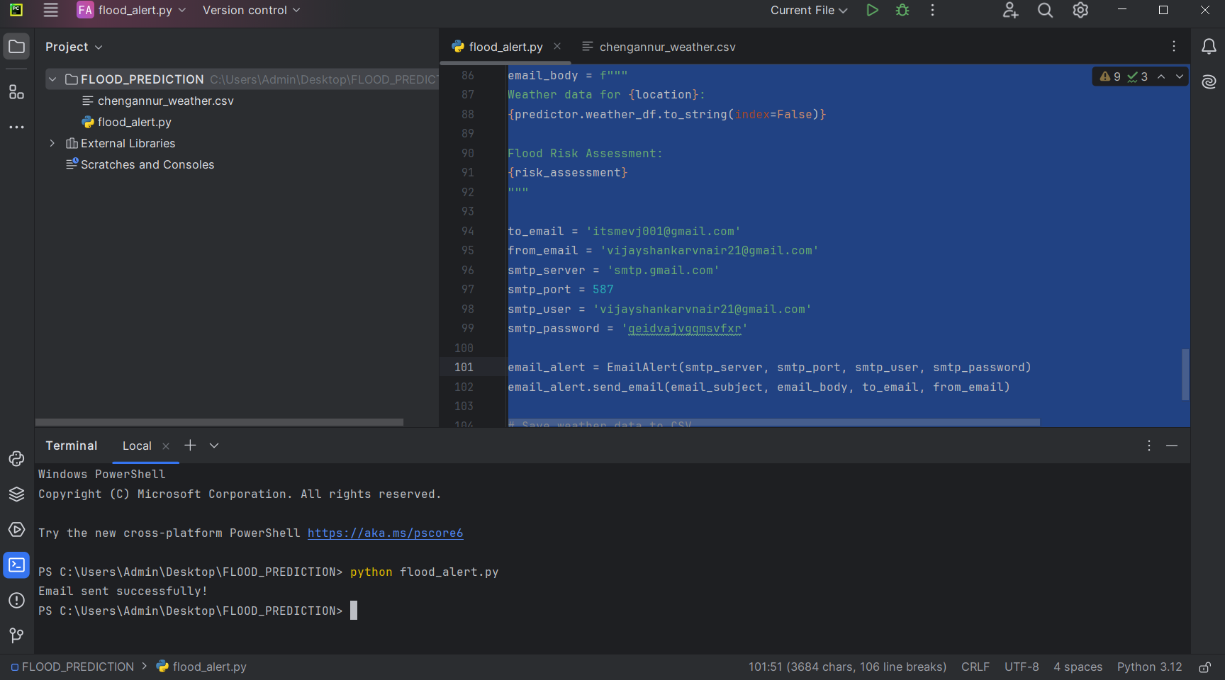
WORK DONE

Slide 9
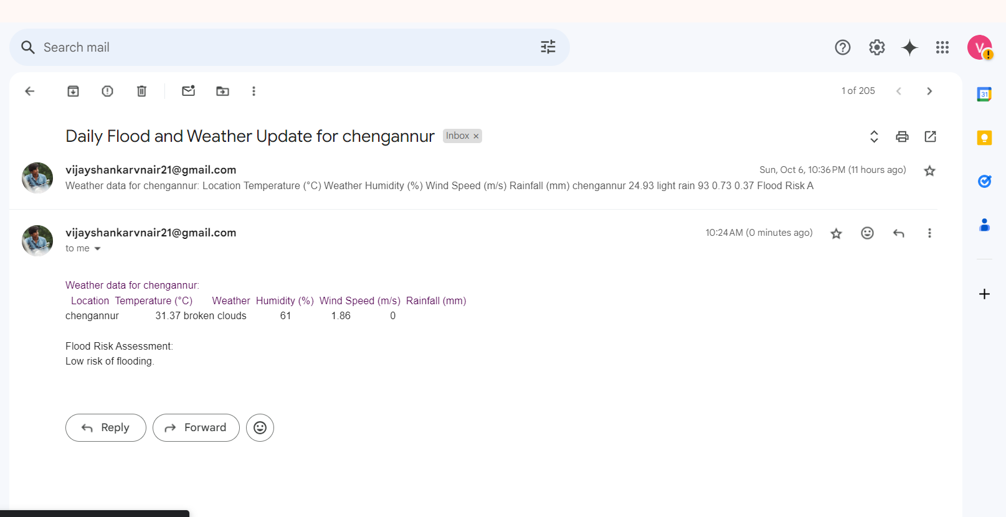
WORK DONE

Slide 10
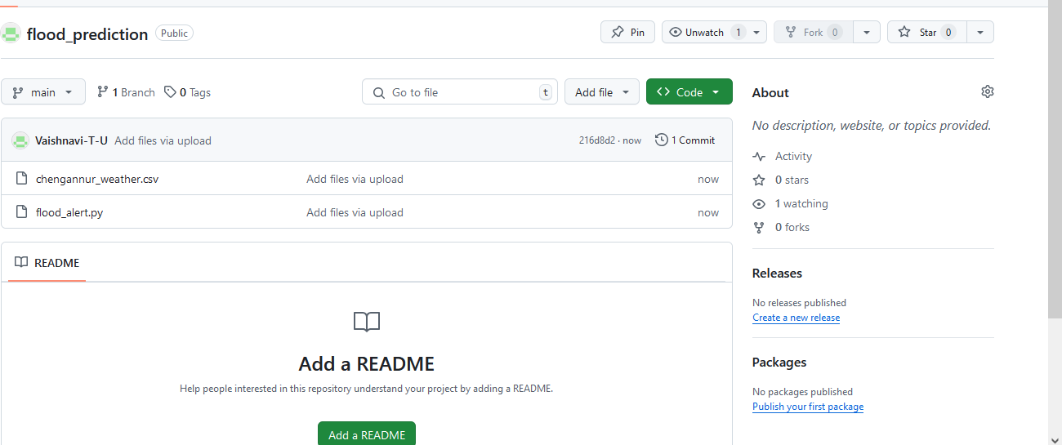
GIT HUB HISTORY

Slide 11

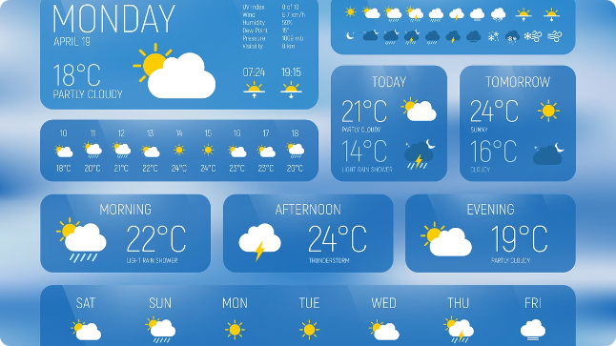
CONCLUSION
The Flood Prediction Alert System enhances flood preparedness by providing real-time, location-based alerts to users. Leveraging machine learning and real-time data, the system predicts flood risks and sends timely email notifications to help users take preventive actions.

Slide 12
REFERENCES
Smith, J., & Brown, L. (2021). Flood Prediction Using Machine Learning Models: A Comparative Study. Journal of Hydrology, 593, 125876.
National Weather Service. (2020). Flood Warning and Forecasting System. Retrieved from https://www.weather.gov/flood
Zhang, H., & Wang, P. (2019). Integration of Real-Time Data in Flood Prediction Models. International Journal of Environmental Science, 18(4), 235-244.
OpenWeatherMap API. (n.d.). Weather Data for Flood Prediction. Retrieved from https://openweathermap.org
Feng, L., & Liu, M. (2020). Disaster Management and Early Warning Systems: Challenges and Advances. Journal of Disaster Risk Reduction, 50, 101752.
Jones, R., & Patel, D. (2022). Email-Based Early Warning Systems for Disaster Management. Communications in Natural Hazards, 12(3), 89-102.

